Slide 1
MITRE, The eCTF, and Side-Channel Analysis

Slide 2


Solving problems for a safer world
© 2020 MITRE #20-2238 8-31-2020
Notes:
Thank you for joining us today! We are excited to share with you WHO MITRE is and WHAT we do. We’re going to start off together here in the main room to learn the basics of MITRE and then we’ll head into some breakout rooms to hear about some of the cool work being done at MITRE directly from our engineers!
Without further ado, let’s dive in!
At MITRE, we’re a company of more than 8,000 innovators, deep thinkers, conveners, and problem solvers who come to work every day to tackle the complex threats facing our nation and the world.
With crises and world events unfolding in ways that nobody expects, we pivot quickly, and proactively lead in the public interest.
We know we must pioneer for a better future.

Slide 3
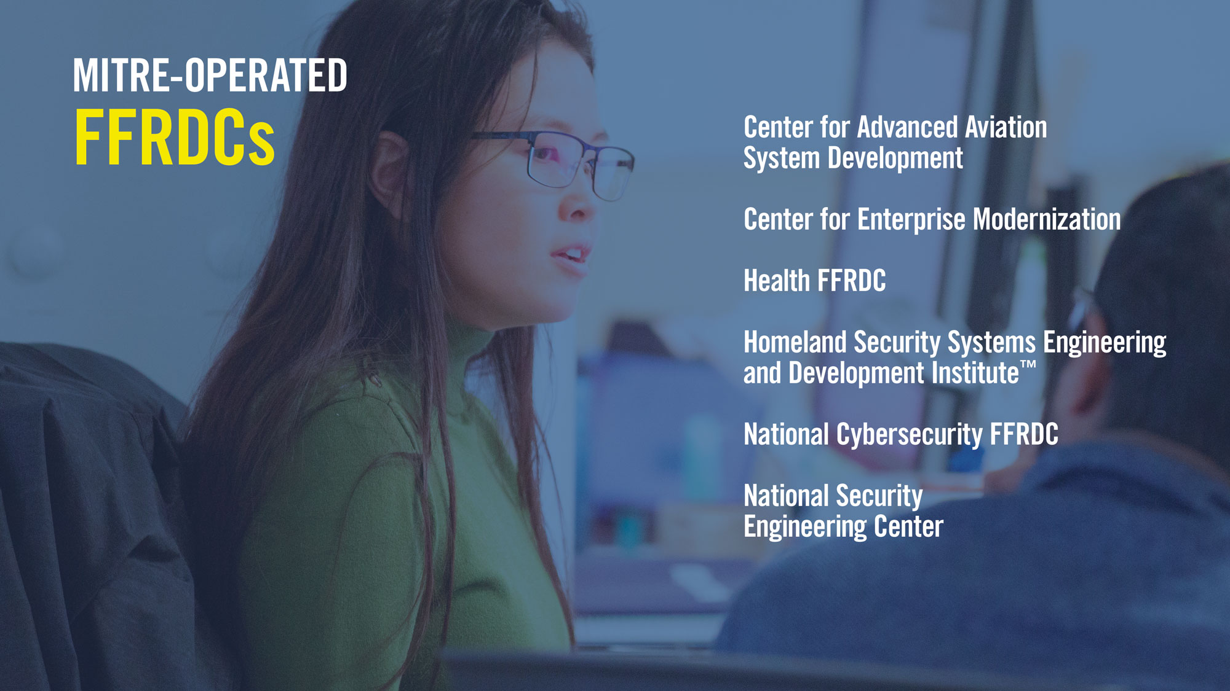
MITRE-Operated FFRDCs: Center for Advanced Aviation System Development, Center for Enterprise Modernization Health FFRDC, Homeland Security Systems Engineering and Development Institute (TM), Judiciary Engineering and Modernization Center, National Cybersecurity FFRDC, National Security Engineering Center
Notes:
Federally funded research and development centers are special organizations that promote objective collaboration to solve large-scale problems—in ways that affect us all, every day.
These unique organizations serve as long-term strategic partners to government, providing objective guidance in an environment free of conflicts of interest.
Today, MITRE operates 6 Federally Funded R&D Centers, working across government and in partnership with industry to tackle challenges to the safety, stability, and well-being of our nation.

Slide 4
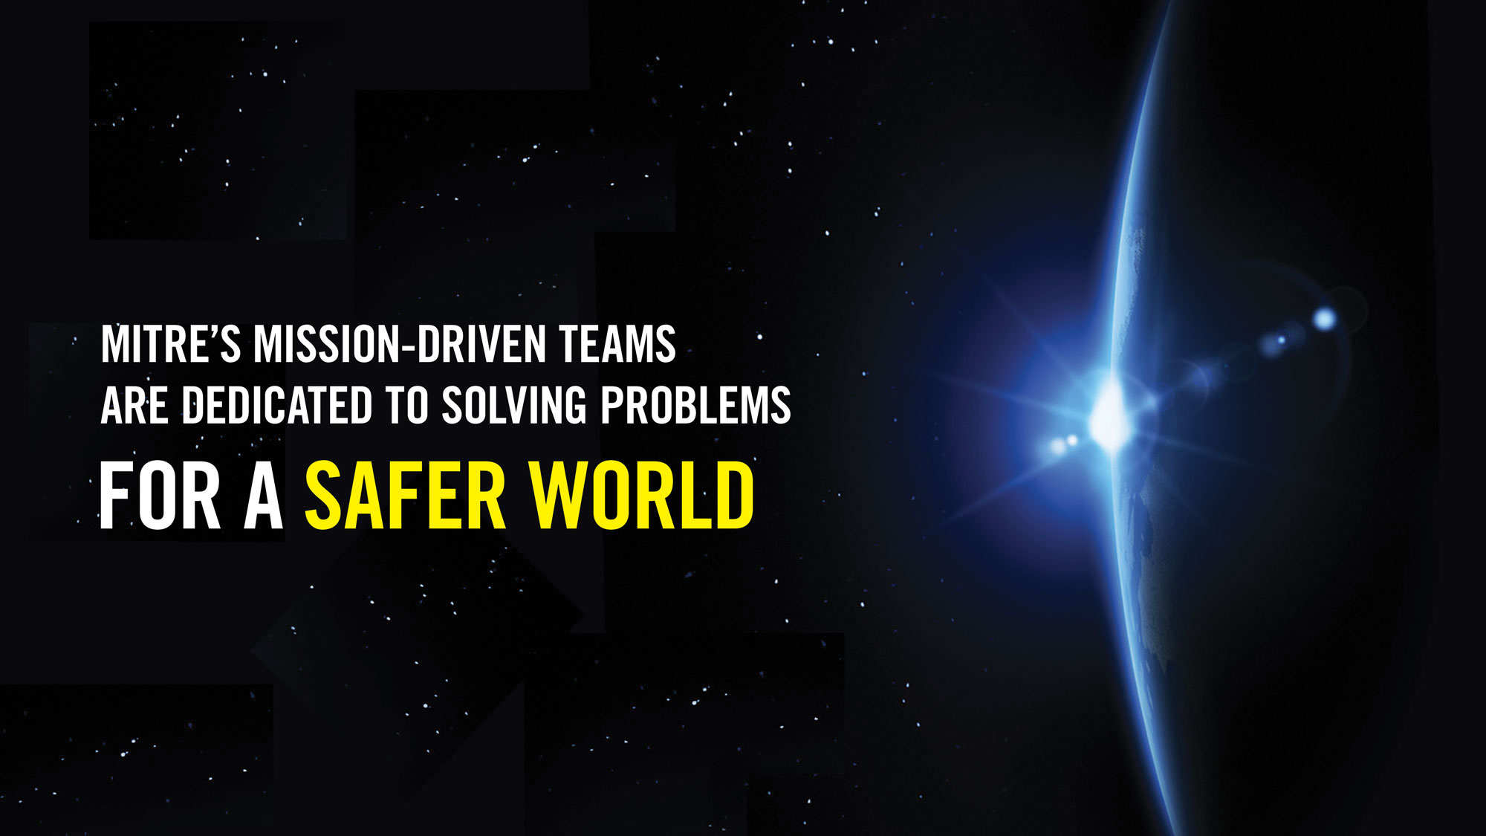
Mission: mitre's mission-driven teams are dedicated to solving problems FOR A SAFER WORLD
Notes:
Through our public-private partnerships and federally funded R&D centers, MITRE works across government and in partnership with industry to tackle challenges to the safety, stability, and well-being of our nation.
We solve tough problems that industry can’t or won’t work on because there isn’t a profit motive or realistic way to get consensus on a solution. We don’t operate with commercial interest. We work in the public interest.
Like developing and supporting the freely available MITRE ATT&CK framework that helps slow down cyber adversaries by exposing the tactics and techniques they use to infiltrate networks.

Slide 5
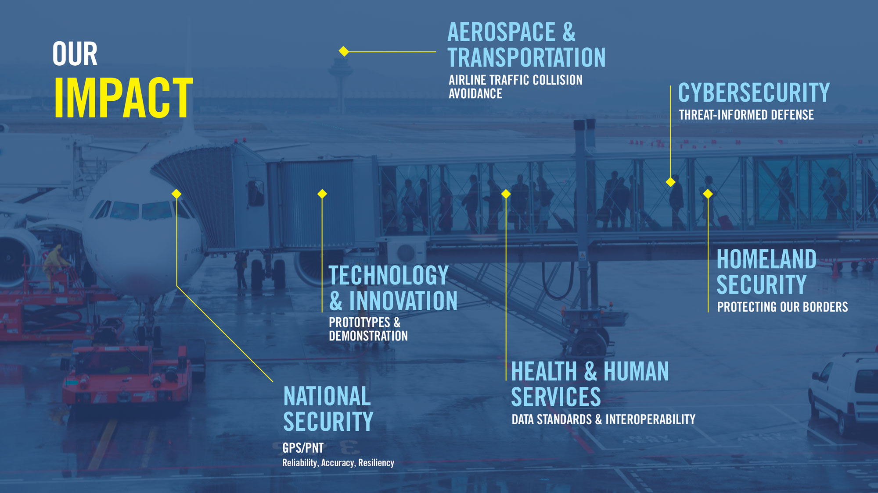
Our Impact: Aerospace & Transportation: Airline Traffic Collision Avoidance, Cybersecurity: Threat-informed Defense, Health & Human Services: Data Standards & Interoperability, Homeland Security: Protecting our borders, National Security: GPS/PNT; reliability, accuracy, resiliency, Technology & Innovation: Prototypes & Demonstration
5
Notes:
In today's complex world, there will always be a need for more evolution, more creativity, more innovation.
We strengthen the systems that protect our way of life in so many important areas.
Our world is complex. Maybe you didn’t know that MITRE’s innovations power todays GPS systems. Or that we pioneered air traffic collision avoidance systems. Or that we are working to unlock the power of electronic health records to improve patient treatment outcomes.

Slide 6

MITRE touches your life Every day
Notes:
For all of us, the world is a safer place because MITRE exists.

Slide 7

SUMMER INTERNSHIPS
Impactful Work
Learning Track Program
Mentorships
Weekly Virtual Meet-Ups
Contests & Competitions
Notes:
Included in those extraordinary people, are our summer interns & co-ops.
As a MITRE intern you can expect your work to directly impact our mission.
You’ll also have the opportunity to participate in Learning Tracks to build out knowledge in new or existing areas of interest, work with mentors, and network with each other while having fun.
Each track will journey through three phases:
Discover. Phase 1 is a presentation by a MITRE leader about the impact of MITRE's work in that area.
Create. During Phase 2, students will receive training in tools, technologies, or topics related to the track. Each curriculum may include a combination of self-paced learning, online resources, courses through the MII, staff lead classes, and “office hours” with track mentors.
Lead. In Phase 3, each track will provide a project or challenge for students to solve that builds on what they’ve learned.

Slide 8

EARLY CAREER PROFESSIONALS
Professional Development
Inclusive Culture
Work/Life Blend
Total Rewards
Continued Education Assistance
Mentor Programs
Notes:
As new grads joining MITRE, you can expect a career filled with opportunity for professional development.
Between our inclusive culture, work/life balance including changing the way we work, where we work etc. and benefits such as Civic Time, Retirement matching, loan repayment assistance and continued education, MITRE’s commitment to our early career professionals is evident.

Slide 9
What is the eCTF?
Design-Build-Attack competition
Run on an embedded platform
Teams must implement a secure design
Functional requirements
Security requirements
College (and even high school) teams from across the country

Slide 10
eCTF Timeline
Secure Design
Handoff
Begins Late-February 2021
eCTF Organizers verify that each design has met all the functional requirements
eCTF Organizers post verified designs for all teams to evaluate during the attack phase
Attack
Teams perform a security evaluation of opposing teams' systems
Teams demonstrate attacks by retrieving flags
Begins Mid-January 2021
Teams attempt to solve development challenges to retrieve design-phase flags
Teams submit their designs to the eCTF Organizers
Teams design a secure system that meets all the challenge requirements
Begins immediately after successful completion of Handoff
Scoreboard closes Mid-April 2021

Slide 11
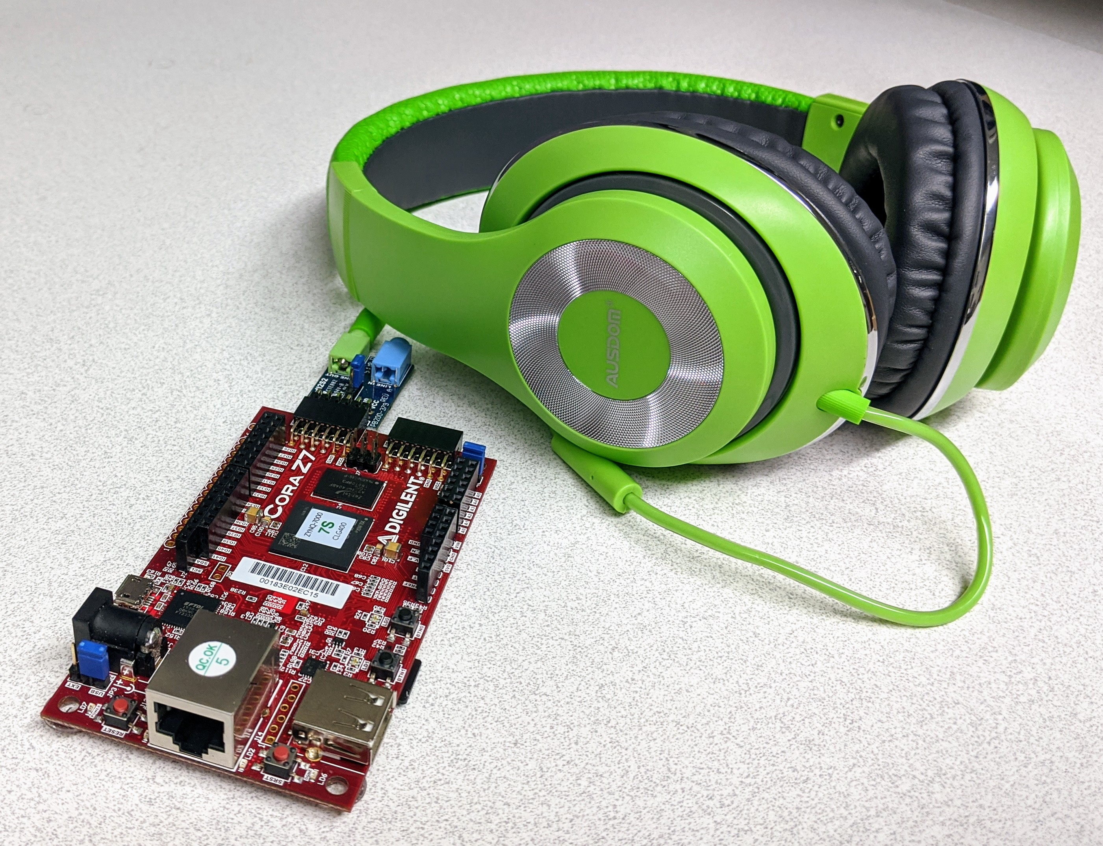
Example Competition
Your team is tasked with designing a secure Digital Rights Management (DRM) module to be used on next generation multimedia player devices
The prototype music player is called…​
…the miPod!
Notes:
DRM is sometimes a contentious topic that people have strong opinions about. Might want to make a point to say that this scenario should not be taken as an indication of our stance on whether or not DRM is a good thing in the world. We simply think that it creates for a very challenging and interesting security scenario.

Slide 12
Why do the eCTF?
Unparalleled hands-on experience
Crypto/protocol design
Low-level C programming
Real-world offensive security
Project management
Career advancement
Looks great on a resume
Massive talent supply shortage in embedded security
It’s fun! (but a lot of work)

Slide 13
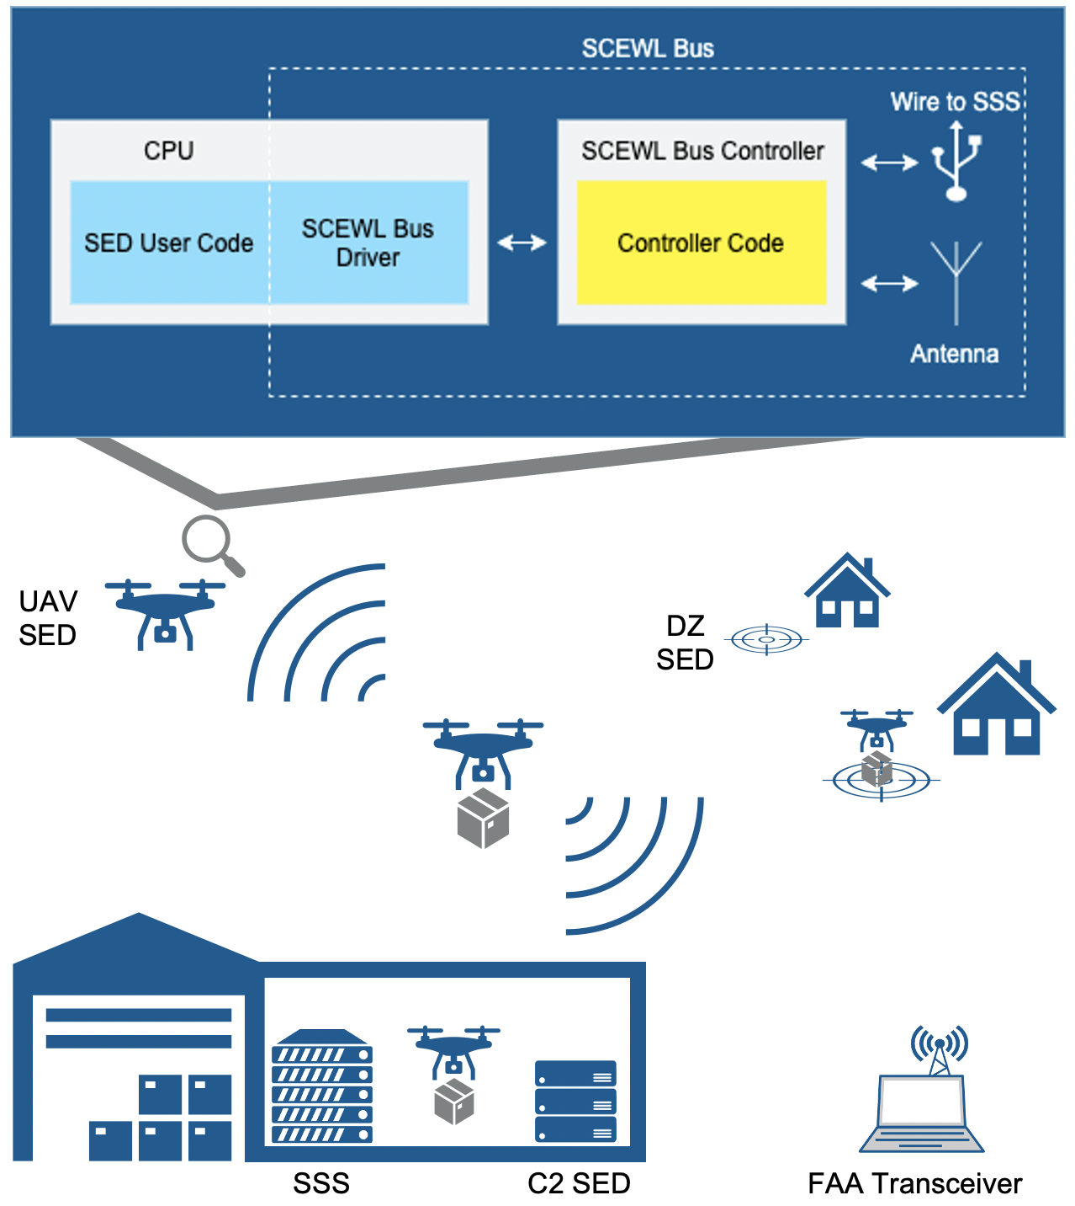
2021 Competition

Slide 14
What is Side-Channel?

Slide 15
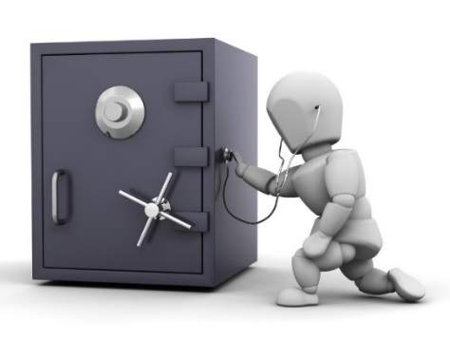
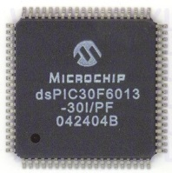
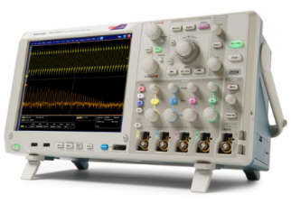
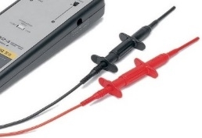
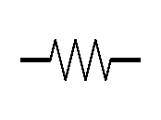
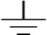
Side-Channel Analogy
Combo
Crypto Keys
Acoustic Side-Channel
Power Side-Channel
Side-channel analysis (SCA) leverage unavoidable side-effects of performing computation

Slide 16
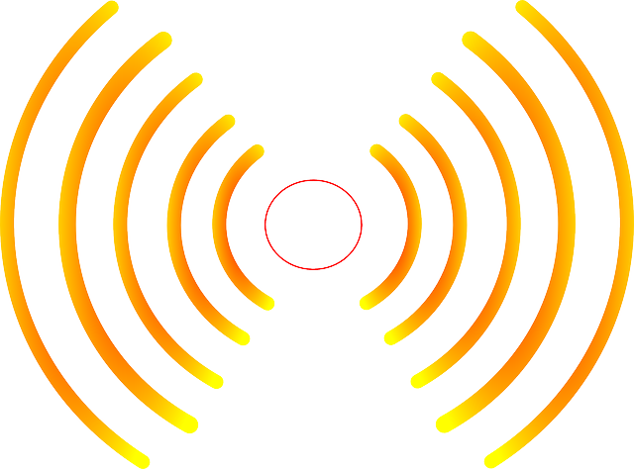

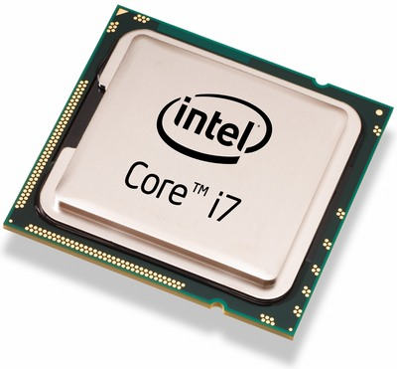

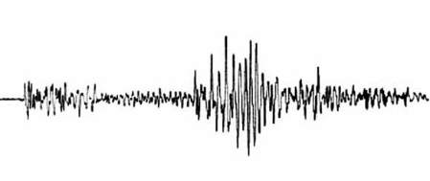
Side-Channel Attacks
SCA commonly used to:
Reverse engineer system operation
Extract information (e.g., keys)
Monitor and validate system behavior
EM Radiation
Thermal
Execution Time
Instantaneous Power
http://www.itp.net/573498-intel-core-i7-920
https://www.kisspng.com/png-light-electromagnetic-spectrum-electromagnetic-rad-1233022/
Acoustic Vibrations
https://pixabay.com/en/thermometer-temperature-rainbow-305319/
https://commons.wikimedia.org/wiki/File:Dtjohnnymonkey-Stopwatch-no-shading.svg
https://commons.wikimedia.org/wiki/File:1989_Loma_Prieta_earthquake_seismogram.jpg

Slide 17
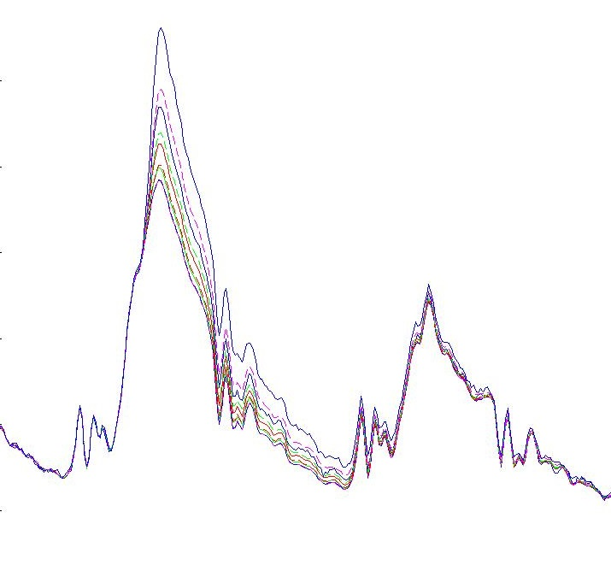
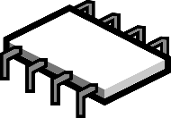
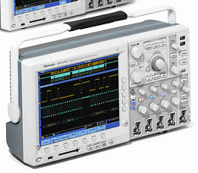
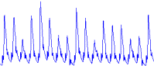

Side-Channel Capture
Side-channel leakage is captured during normal device operation
Target device is instrumented with sensors (e.g., current monitor)
Device commanded to perform its sensitive operation
Captured side-channel data is stored along with the corresponding inputs and outputs
Data-dependent power consumption
Data
Power Consumption
Photo: Tektronix Inc.
Time
Chip Image Source: https://pixabay.com/en/microchip-component-computer-chip-309407/
Battery Image Source: Tango Desktop Project
© 2018 MITRE Corporation

Slide 18
Side-Channel Workshop
https://mybinder.org/v2/gh/janisbent/sc-lab/main?filepath=lab.ipynb

Slide 19
Ben Janis
btjanis@mitre.org
linkedin.com/in/benjanis

